Slide 1
What is AI Agnt?
Intelligent agents that perceive environment and achieve goats
Notes:
AI agents are intelligent entities that can perceive their environment, reason about it, and take actions to achieve goals. In this presentation, we will explore the concept and application of AI agents.

Slide 2
Agenda Items
Concept of AI Agent.
Application of AI Agent.
Notes:
We will start by delving into the concept of AI agents, exploring their definition and the different types of AI agents. Then, we will examine some of the most exciting applications of AI agents, from virtual assistants to autonomous driving.

Slide 3
Concept of AI Agent
Notes:
An AI agent is an autonomous entity that can perceive its environment, reason about it, and take actions to achieve its goals. We will explore the different types of AI agents, such as reactive agents, deliberative agents, and learning agents.

Slide 4

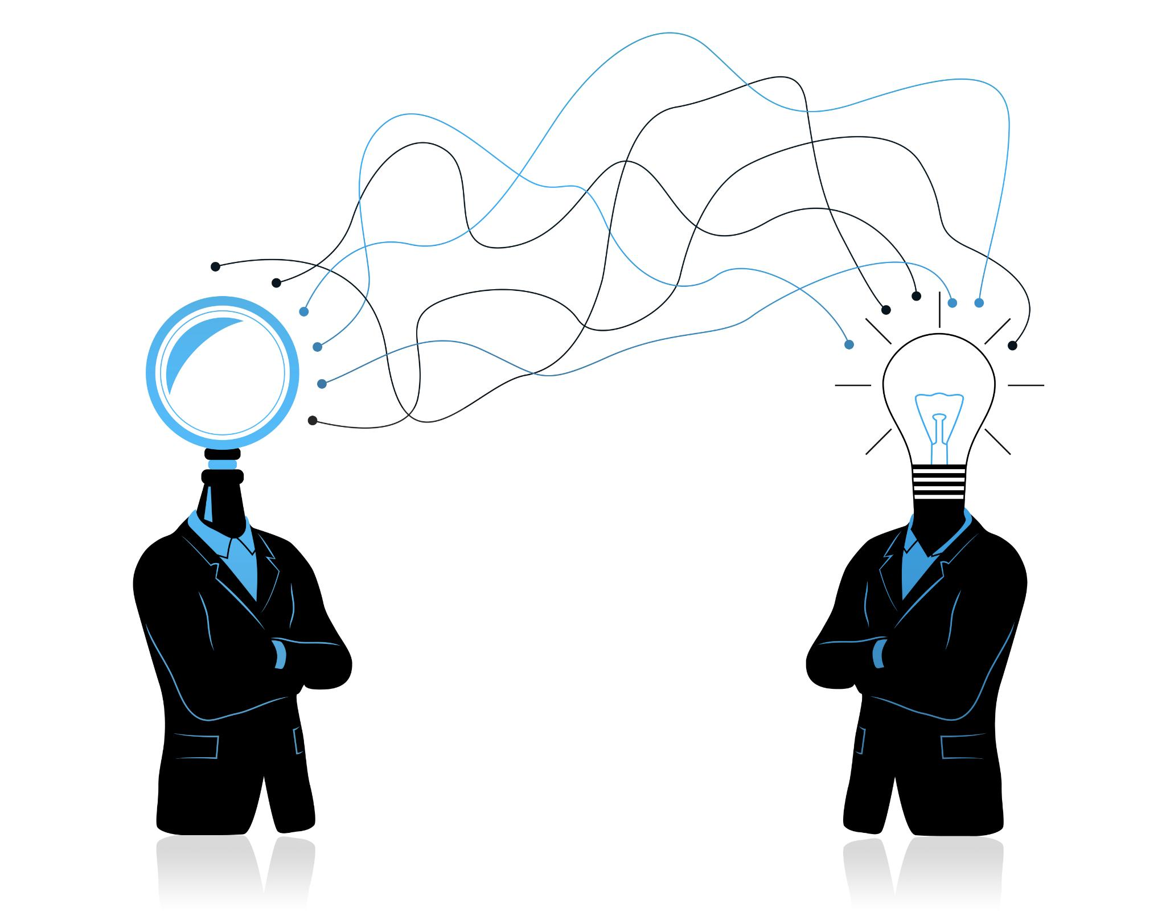
Definition of AI Agent
An AI agent is an intelligent entity that perceves its environment and takes actions to achieve its goals. AI agents can be designed to interact with other agents and their environment, and they can learn from their experiences.
Notes:
An AI agent is an intelligent entity that perceives its environment and takes actions to achieve its goals. AI agents can be designed to interact with other agents and their environment, and they can learn from their experiences.

Slide 5

Types of AI Agent
Reactive Agents
Reactive agents are the simplest type of AI agents that can only react to their environment. They do not have the ability to learn or reason about their environment. However, they are fast and efficient in their decision-making process.
Deliberative Agents
Deliberative agents are more complex than reactive agents and can reason about their environment and plan their actions. They can learn from their environment and improve their decision-making process over time. However, their decision-making process is slower than reactive agents.
Learning Agents
Learning agents are the most complex type of AI agents that can adapt and improve their behavior over time. They can learn from their environment and interactions, and their decision-making process improves with experience. However, they require a lot of data and time to train, and their decision-making process is slower than reactive and deliberative agents.
Notes:
There are several types of AI agents, each with its own strengths and weaknesses. Reactive agents can only react to their environment, while deliberative agents can reason about their environment and plan their actions. Learning agents can adapt and improve their behavior over time.

Slide 6

Virtual Assistants
Virtual assistants are AI agents that can understand natural language and perform tasks based on voice comands. They can help users with a variety of tasks, such as scheduling appointments, sending messages, and searching the web.
Notes:
Virtual assistants, such as Siri and Alexa, are AI agents that can understand natural language and perform tasks based on voice commands. They can help users with a variety of tasks, such as scheduling appointments, sending messages, and searching the web.

Slide 7
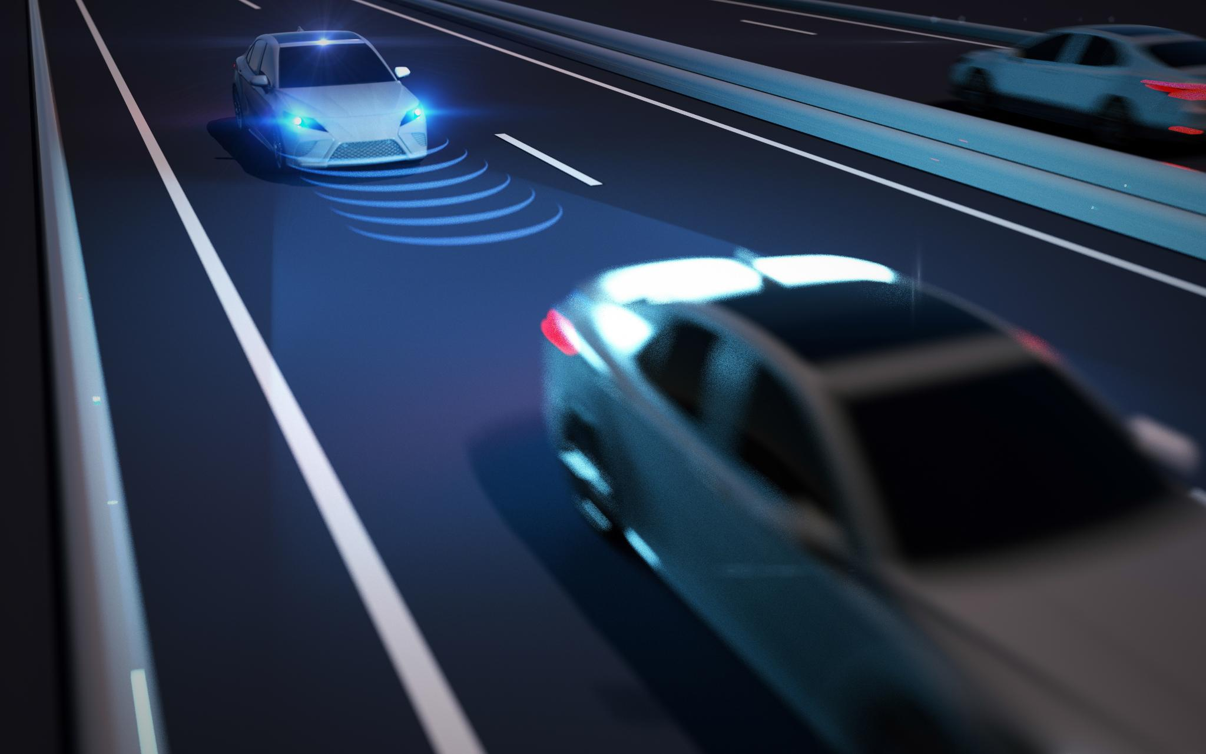
Autonomous Driving
AI Agents for Autonomous Driving
Autonomous driving is an application of AI agents that allows vehicles to drive themselves without human intervention. AI agents use a variety of sensors and algorithms to perceive their environment, make decisions, and navigate safely on the road. This technology has the potential to revolutionize the automotive industry and make driving safer and more efficient.
Perception and Decision Making
Self-driving cars use a variety of sensors such as cameras, lidars and radars, and AI algorithms to perceive their environment, make decisions, and navigate safely on the road. These technologies enable vehicles to detect and respond to obstacles, traffic signals, and other vehicles on the road.
Notes:
Autonomous driving is an application of AI agents that allows vehicles to drive themselves without human intervention. Self-driving cars use a variety of sensors and algorithms to perceive their environment, make decisions, and navigate safely on the road.

Slide 8
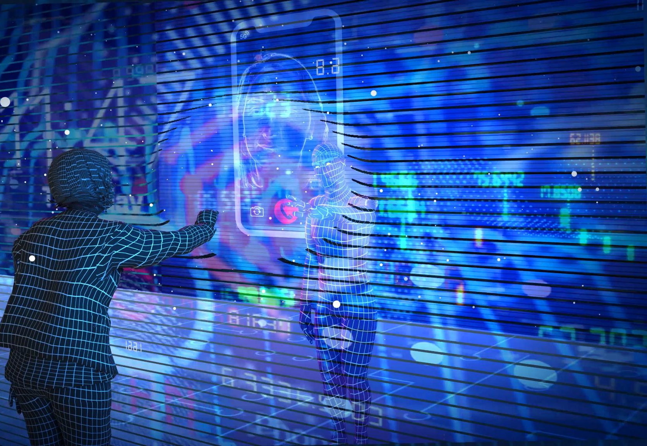
Other Scenarios
Here is an example to test if the agent can recognize the terminology or the terms in the memory, like AgWf.
Also, it can recognize the wrong words with upper case like MSFTT, which would be ignore by spelling check.
Notes:
AI agents can also be used to detect fraud and other forms of financial crime. Fraud detection agents can analyze large volumes of data to identify suspicious patterns and behaviors, helping to prevent financial losses and protect consumers.

